Slide 1
Restaurants of Bengaluru
Daksh Parikh
Machine Learning

Slide 2
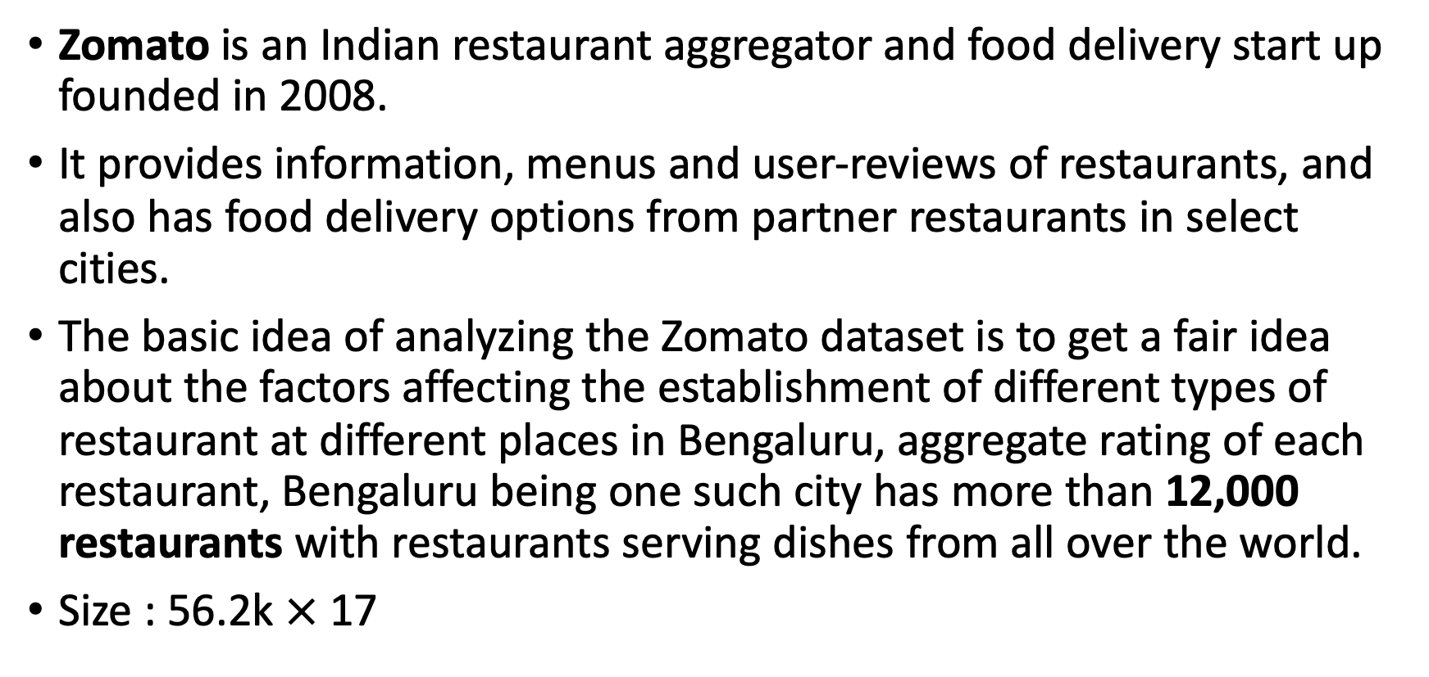
Zomato Bangalore Restaurants
Zomato is an Indian restaurant aggregator and food delivery start up founded in 2008.
It provides information, menus and user-reviews of restaurants, and also has food delivery options from partner restaurants in select cities.
The basic idea of analyzing the Zomato dataset is to get a fair idea about the factors affecting the establishment of different types of restaurant at different places in Bengaluru, aggregate rating of each restaurant, Bengaluru being one such city has more than 12,000 restaurants with restaurants serving dishes from all over the world.
Size : 56.2k $×$ 17

Slide 3
Columns:
URL contains | Phone number of the restaurant
Name of the restaurant | The neighborhood in which the restaurant is located
Address of the restaurant in Bengaluru | Restaurant type
online ordering is available in the restaurant or not | Dishes which people liked in the restaurant
book table option available or not | Cuisines food - styles, separated by comma
Overall rating of the restaurant out of 5 | The approximate cost for meal for two people
Total number of rating for the restaurant | The neighborhood in which the restaurant is listed

Slide 4
Booking table

Slide 5
Online order

Slide 6
Average cost

Slide 7
Arear wise restaurants

Slide 8
cleaning dataset
Delete few columns
URL
Address
Phone
location
Replace NaN
Drop some raw with dropna and drop_duplicates functions
Used LabelEncoder() for convert all objects columns to float64

Slide 9
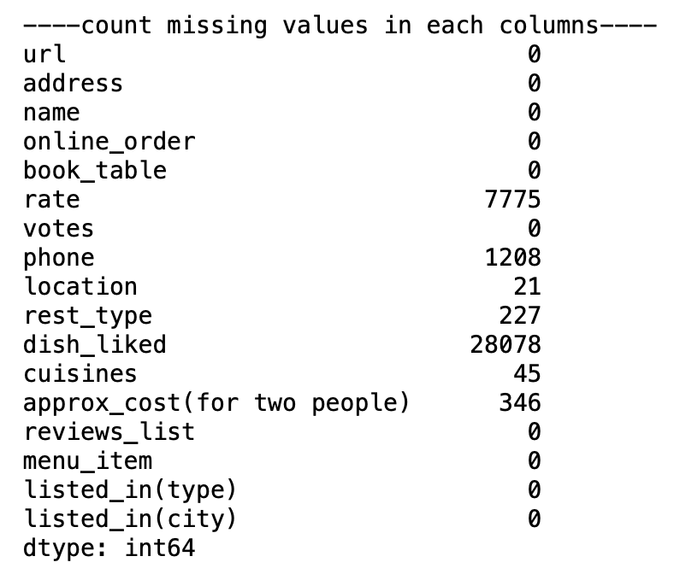
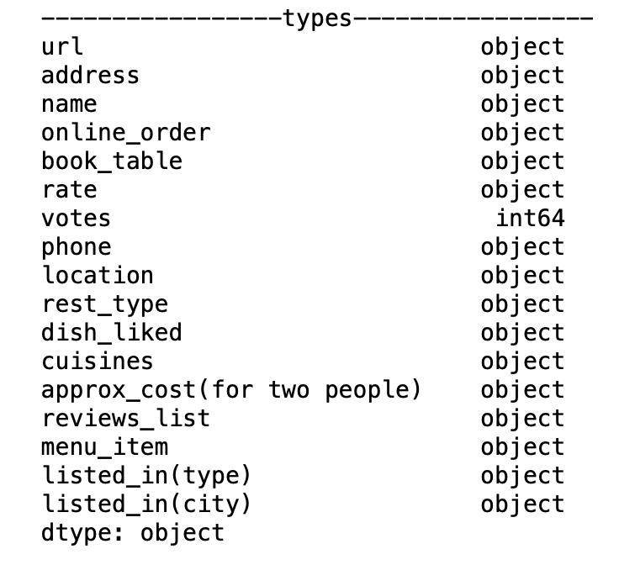
Types and missing values

Slide 10
Regression Analysis for ratting
Linear Regressor – 28.8%
Random Forest Regressor – 98.4%
Ridge Regressor – 28.8%
Lasso Regressor – 28.7%
KNN regressor – 72.9%

Slide 11
To make better models
One hot encoding
Rest type
type
city
cuisines
Dish liked
Standardize data with standard scaler
Feature selection

Slide 12
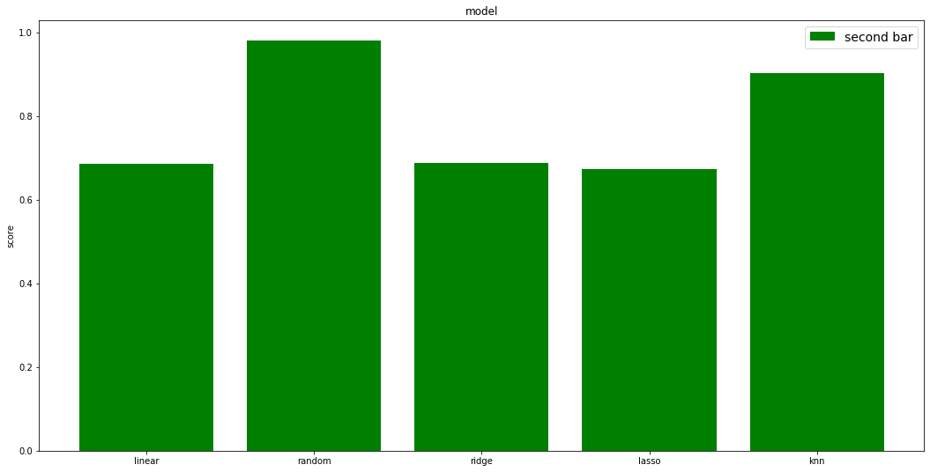
New Regression Analysis for ratting
Linear Regressor – 68.4%
Random Forest Regressor – 98%
Ridge Regressor – 68.8%
Lasso Regressor – 67.3%
KNN regressor – 90.3%

Slide 13
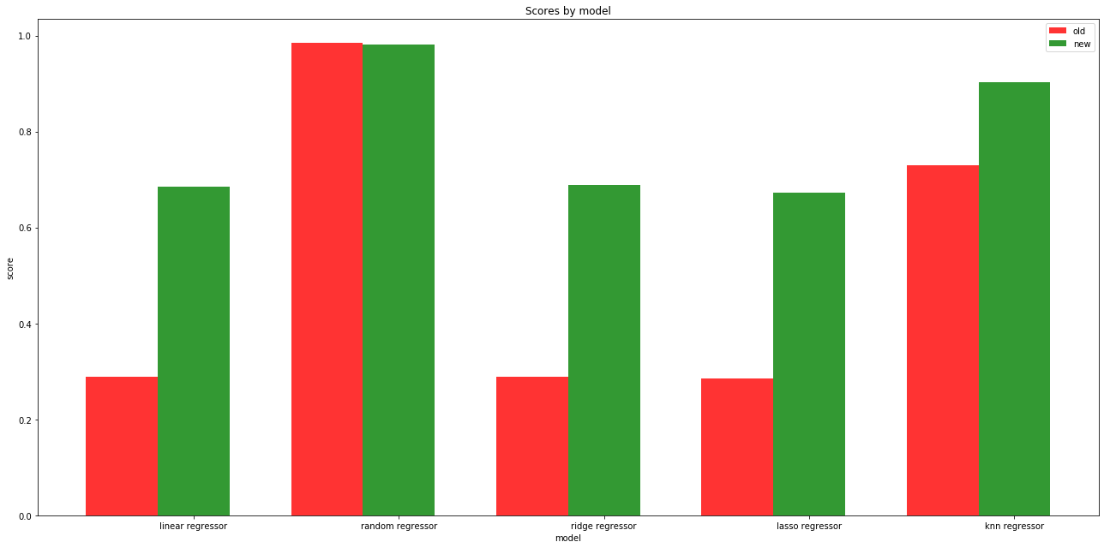
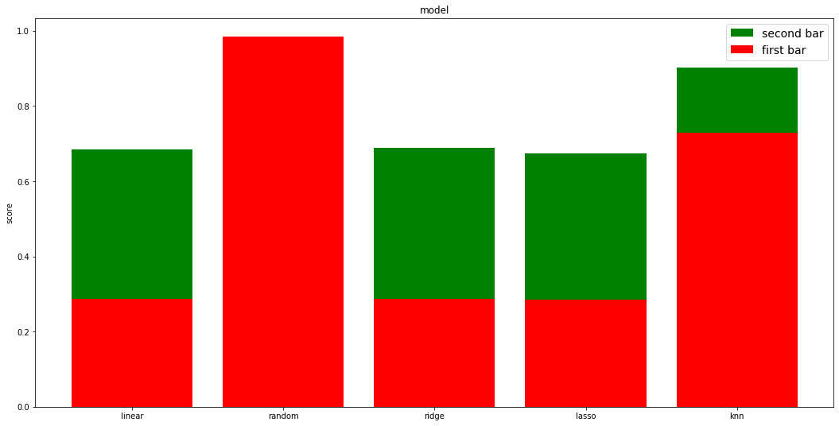
Difference between old and new models

Slide 14
Conclusion
Using One Hot Encoding and scaling is very useful for most of the model it will increase your accuracy up to 40% and it is huge. But as we can see Random Forest is unbeatable.
And my assumption is this happening because Random Forest is an ensemble machine learning algorithm which use Bootstrap Aggregation or bagging.

Slide 15
Mulit-label Classification task
We will be using mulit-label classification, basically, we will be wanting to know whether a restuarant can accept online order and booking table or not based on the given data. We don't need to standardize the data in classification task.
Random Forest Classifier – 91.34%
KNN classifier – 85.55%

